Slide 1
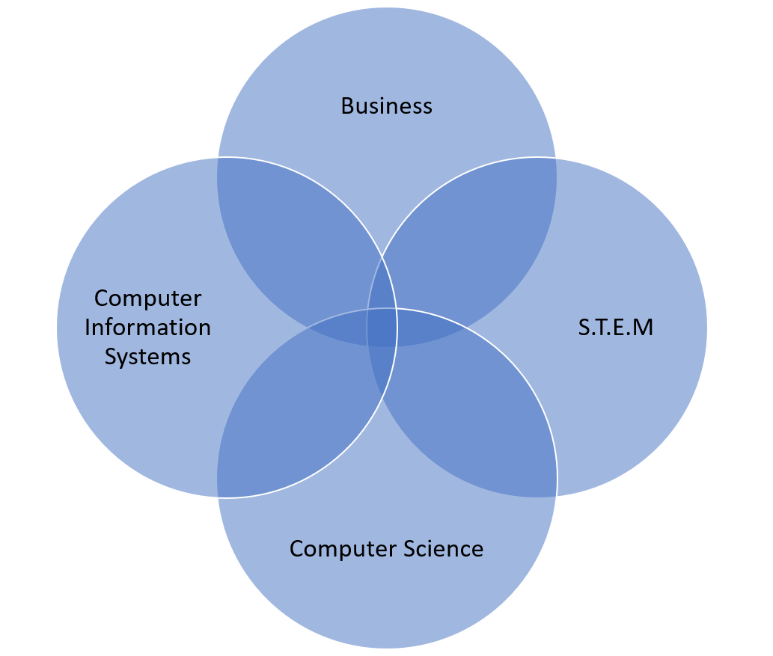
Introduction to The Catalyst at Belhaven University
Innovating purposefully, merging technology, faith, and entrepreneurship for societal impact
Innovate, Create, Solve – It’s What We Do.

Slide 2
Space and Vision
Electronic billboard on front entrance - Members, brief video with sound
Marquee with "The Catalyst at Belhaven" in school colors green and gold
Company name above door in the same font, but slightly smaller
Fishbowl writable glass walls on the VR lab
Tables for brochures

Slide 3
Mission and Vision
Integrating technology and education with Christian values
Accelerator Program
Research Collaborations
Educational Initiatives
Community Outreach
Notes:
Accelerator Program: Supporting startups and entrepreneurs in developing scalable solutions, providing mentorship, funding, and resources.
Research Collaborations: Engaging in research projects with academic institutions, industry, and non-profit organizations, focusing on the ethical use of technology and innovative software applications and related services.
Educational Initiatives: Providing workshops, seminars, and courses that align with Belhaven University's mission and curriculum.
Community Outreach: Extending our Christian values to the community through technology awareness programs, accessibility initiatives, and social responsibility projects.

Slide 4
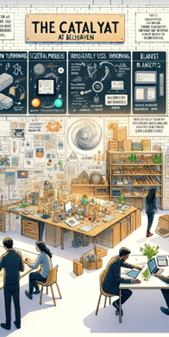
Core Pillars Overview
EdTech – statistically improve educational outcomes
Supplier Diversity –services to local, national, and international businesses
Arts – “No starving artist syndrome”
Sustainability –zero waste initiatives.
Micro credentialing – stackable skills development
Notes:
Figure 1: DALL-E Generated Image: The Catalyst at Belhaven
Edtech – Leveraging the potential of VR and AI to revolutionize education, creating immersive and personalized learning experiences that foster growth and understanding. Edtech is enhanced by focusing on purpose-driven, culturally relevant learning experiences and fostering innovative approaches in educational content and delivery.
Supplier Diversity – Championing diversity through inclusive supplier proposal development, fostering a rich ecosystem of varied perspectives and innovative solutions. This pillar champions an inclusive business ecosystem supporting cooperative development and economic empowerment, promoting autonomy among diverse suppliers.
Arts – Bridging tradition and modernity, where the worlds of arts and technology converge, offering immersive experiences and nurturing creativity through AI applications in arts. Arts will be driven by encouraging innovation and fostering collaborations among diverse artists, creating a unified and vibrant artistic community.
Sustainability – Embarking on a path of conscious development with zero waste guidelines, ensuring a future that is not just technologically advanced but also sustainable and harmonious with nature. Sustainability initiatives are underlined by a belief in a better world and moral imperative to protect the environment, encouraging community participation and collective responsibility.

Slide 5
Supplier Diversity and Economic Empowerment
Advocate
Strategize
Champion
Foster
Diversity and Inclusion
Notes:
Advocating for inclusive growth.
Strategies for fostering a diverse business ecosystem.
Championing diversity through inclusive supplier proposal development
Fostering a rich ecosystem of varied perspectives and innovative solutions.
This pillar champions an inclusive business ecosystem supporting cooperative development and economic empowerment, promoting autonomy among diverse suppliers.

Slide 6
Arts and Technology
Artistic Expression.
Intersection of Art and Technology
Community
Notes:
Integration of technology in artistic expression.
Promoting innovation and creativity innovative thinking.
Bridging tradition and modernity, where the worlds of arts and technology converge, offering immersive experiences and nurturing creativity through AI applications in arts. Arts will be driven by encouraging innovation and fostering collaborations among diverse artists, creating a unified and vibrant artistic community

Slide 7
Commitment to Sustainability
Zero waste initiatives and innovative reuse of resources.
Emphasizing environmentally responsible practices.
Notes:
Zero waste initiatives and innovative reuse of resources.
Emphasizing environmentally responsible practices.
Embarking on a path of conscious development with zero waste guidelines, ensuring a future that is not just technologically advanced but also sustainable and harmonious with nature. Sustainability initiatives are underlined by a belief in a better world and moral imperative to protect the environment, encouraging community participation and collective responsibility.

Slide 8
Micro Credentialing
Skill-Based Certifications: Focus on acquiring specific, in-demand skills.
Flexible Learning Pathways: Allows students to learn at their own pace.
Enhances Employability: Provides credentials that employers value.
Quick Recognition of Skills: Earn certifications in shorter timeframes than traditional degrees.
Bridges the Gap Between Education and Industry: Aligns educational outcomes with real-world job requirements.
Stackable Credentials: Can be accumulated over time to build towards larger qualifications.
Accessible for All Students: Offers low-cost or free learning opportunities for skill development.

Slide 9
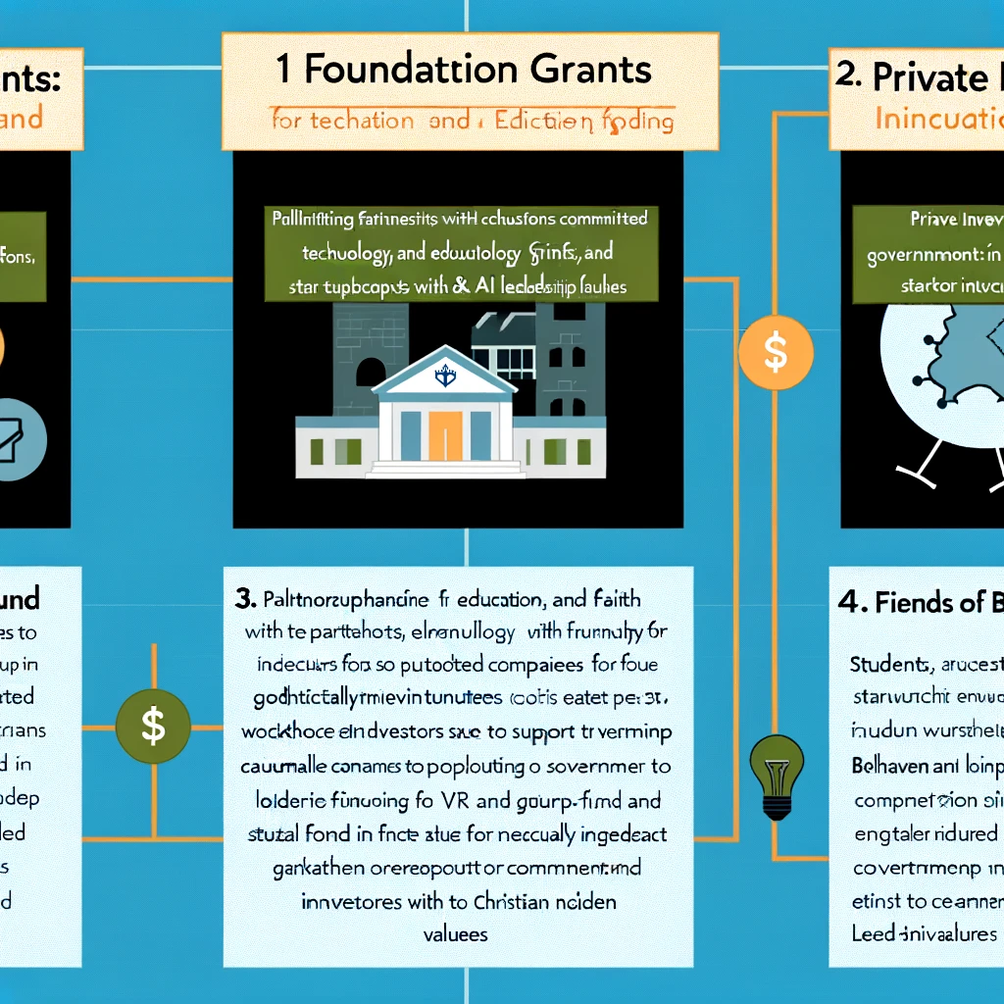
Potential Funding, Support, and Partnerships options
Grants
Foundation Grants
Workforce Development Grants
Friends of Belhaven
Trail-Blazer Fund
The Catalyst Fund
Enterprise Fund
Private Investors
Self Funding
Notes:
Foundation Grants: By seeking partnerships with foundations that share our commitment to education, technology, and faith, we will secure essential funding for research and development.
Private Investors: Aligning with ethically minded private investors will enable us to foster entrepreneurship and incubate startups that align with our Christian values.
Workforce Development Grants: Through partnerships with government and industry, we will acquire workforce development grants to prepare the next generation of leaders in VR and AI.
Friends of Belhaven: Through annual outreach campaigns the incubator will appeal to alumni and friends for contributions to investment funds structured with an equity stake in the companies that receive funding.
Trail-Blazer Fund – Portfolio includes student lead companies in the incubator
The Catalyst Fund – Portfolio includes faculty lead companies in the incubator
Enterprise Fund – Direct investment private companies within 6 months of exiting the incubator after becoming profitable from sales or contract revenue.
Self Funding: Through gross sales sharing as a tax of doing business and a reduced space rental rate for the duration of the residency in the incubator.

Slide 10
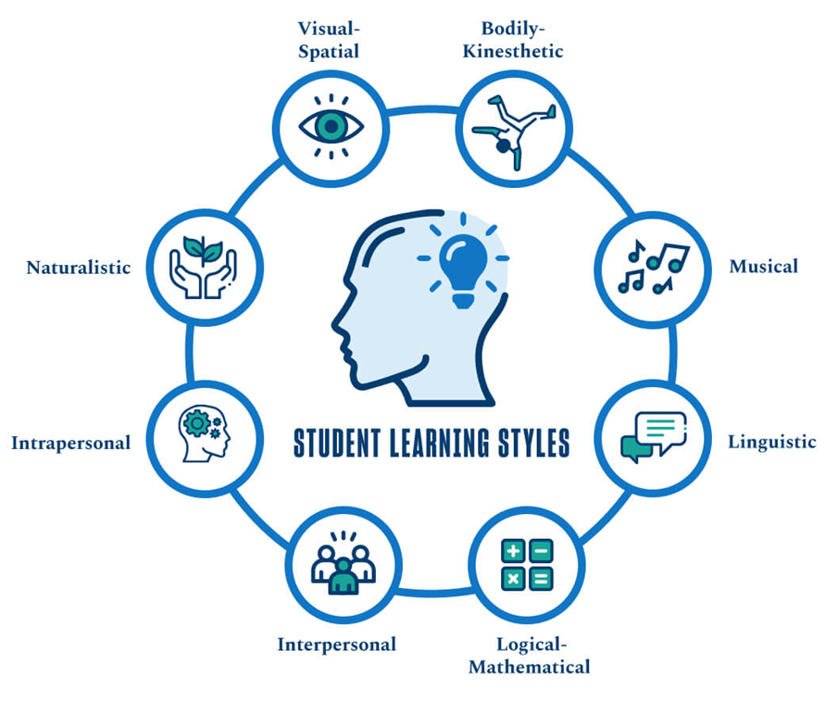
Programs, Activities, and Community Engagement
Highlight the Potential
Showcase Impact
Build curriculum
Develop lecture series
Notes:
Highlight the Accelerator Program, research collaborations, educational initiatives, and community outreach.
Showcase potential impact and benefits for students and the wider community.
Structured 6 months curriculum based on entrepreneurial curriculum and other best practices

Slide 11
Self-funding: Analytics as a Service Company
Problem Statement:
Small businesses collect a significant amount of data but may not have the capacity to analyze the data and develop a strategy that will provide long-term strategic advantages.
Description of the Solution:
Data analytics to create information for small to medium-sized businesses. Application of data analysis techniques to turn raw data into actionable
Data Capture strategy development
Data Storage strategy development
Revenue share
5% - Charity
10% gross revenue tax to Incubator

Slide 12
Self-funding: My Tea Butler (Herbalyst)
Problem Statement:
Holistic remedy for common conditions with herbal tea
Description of the Solution:
A large language model was applied to determine herbal tea recipes based on the described ailments.
Ingredient list
Integration with Instacart
Inventory management
Revenue share
5% - Charity
10% gross revenue tax to Incubator

Slide 13
Vision and Mission (Years 1-5)
Vision: To be a nationally recognized innovation hub.
01
Integrate technology and education with Christian worldview.
02
Focus on real-world impact through STEM, analytics, and the arts.
03
Promote sustainability and diverse supplier engagement.
04

Slide 14
Strategic Priorities for Growth
Key Areas:
Expand EdTech Initiatives
Increase Research and Collaboration
Enhance Supplier Diversity and Business Growth
Develop Arts and Technology Integration
Promote Sustainability and Zero-Waste Initiatives

Slide 15
Expand EdTech Initiatives
Goal: Leading center for immersive learning by 2028.
Years 1-2: Expand VR and AI labs, offer pilot programs.
Years 3-4: Scale programs, partner with industry.
Year 5: Establish 'Data Analytics as a Service' for small businesses.

Slide 16
Increase Research and Collaboration
Goal: Launch Research Hub focused on STEM, data, and business.
1
Years 1-2: Secure partnerships with academic institutions and industry.
2
Year 3: Develop faculty/student-led research projects.
3
Years 4-5: Establish formal Research Hub, secure grants.
4

Slide 17
Enhance Supplier Diversity and Business Growth
Goal: Lead in promoting diversity-driven business ecosystems.
Year 1: Create guidelines for diverse supplier proposal development.
Years 2-3: Offer workshops and consultancy services.
Years 4-5: Establish 'Supplier Diversity as a Service'.

Slide 18
Develop Arts and Technology Integration
Goal: Drive innovation at the intersection of arts and technology.
Year 1: Launch workshops on AI and VR in arts.
Years 2-3: Promote arts entrepreneurship with accelerator programs.
Years 4-5: Establish 'Arts and Tech Innovation Hub'.

Slide 19
Promote Sustainability and Zero-Waste Initiatives
Goal: Foster a sustainable environment and become a model for zero-waste technology.
Year 1: Implement zero-waste guidelines and composting initiative.
Years 2-3: Integrate sustainable practices (reuse coffee grounds, etc.).
Years 4-5: Host annual sustainability symposiums.

Slide 20
Micro Credentials
Year 1: Launch & Foundation
- Start with foundational AWS certifications (Cloud Practitioner, Solutions Architect)
- Partner with AWS Academy & local tech companies
• Year 2: Expansion
- Add advanced certifications & related micro-credentials (e.g., DevOps, Security)
- Establish internships & industry partnerships
• Year 3: Scaling & Integration
- Embed micro-credentials into curriculum across departments
- Offer online courses & corporate training
• Year 4: Diversification
- Introduce Professional & Specialty certifications (AI, Big Data)
- Develop stackable credentials leading to degrees
• Year 5: Recognition & Global Reach
- Seek accreditation & program recognition
- Expand internationally & establish a cloud research lab

Slide 21
Community Engagement & Funding
Key Actions:
Increase engagement by 25% by 2025.
Launch a startup accelerator for 10 student-led startups annually by 2026.
Develop certification pathways with AWS and CompTIA.
Secure 10 grants and raise $400,000 via tenants by Year 5.

Slide 22
Join Us in Shaping the Future
Contact information: 601-973-5004
TheCatalyst@Belhaven.edu
www.TheCatalystAtBelhaven.org
cwicks@belhaven.edu
Special thanks to Bryant Butler(logo), Brett Andrews (name and support), John Estes (support and encouragement).
Notes:
As we stand at the confluence of foresight and faith, THE CATALYST AT BELHAVEN UNIVERSITY (THE CATALYST) outlines a budget and fundraising strategy deeply anchored in Christian worldview and principles. The three-year plan, steeped in S.M.A.R.T goals, serves as a blueprint, not just for financial growth, but for nurturing a community that embodies the teachings of Christ in every endeavor.
Our pathway to success is illuminated by the teachings of the scripture, where stewardship, compassion, and community take center stage. We seek to foster a fertile ground for innovation and growth where every initiative, be it in the realm of Edtech, Supplier Diversity, Arts, or Sustainability, is nurtured to fruition through resources garnered through Grants, Tenants, and the benevolent Friends of Belhaven.
It is our mission to foster a culture that embodies the Christian virtues of love, service, and ethical engagement, ensuring that every dollar invested translates into value - value that nourishes minds, fosters talents, and builds a sustainable and compassionate society, echoing the love of Christ in every facet.
As we forge ahead, our steps are guided by the Christian worldview, a compass that directs us to not only achieve material growth but to build a legacy of love, understanding, and mutual respect. We invite you to be a part of this Christ-centered journey, to contribute to a future where success is not just measured in economic gains but in the enrichment of souls, and the harmony of a community walking in the path of Christian teachings, united in purpose and spirit.

